Slide 1
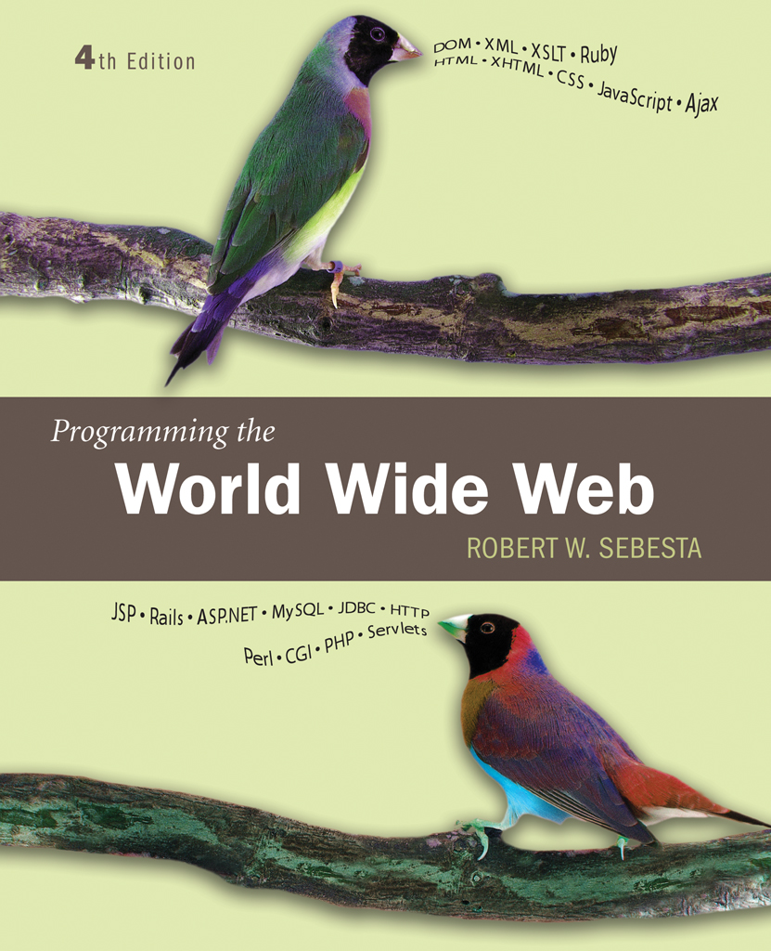
Chapter 1
Fundamentals

Slide 2
1.1 A Brief Intro to the Internet
Internet History
Internet Protocols

Slide 3
1.1 Internet History
Origins
  ARPAnet - late 1960s and early 1970s
    Network reliability
    For ARPA-funded research organizations
BITnet, CSnet - late 1970s & early 1980s
    email and file transfer for other institutions
  NSFnet - 1986
    Originally for non-DOD funded places
    Initially connected five supercomputer centers
    By 1990, it had replaced ARPAnet for non-military uses
    Soon became the network for all (by the early 1990s)
  NSFnet eventually became known as the Internet

Slide 4
1.1 Internet History
What the Internet is:
    A world-wide network of computer networks
    At the lowest level, since 1982, all connections use TCP/IP
    TCP/IP hides the differences among devices connected to the Internet

Slide 5
1.1 Internet Protocols
Internet Protocol (IP) Addresses
  Every node has a unique numeric address
  Form: 32-bit binary number
    New standard, IPv6, has 128 bits (1998)
Organizations are assigned groups of IPs for their computers
Problem: By the mid-1980s, several different protocols had been invented and were being used on the Internet, all with different user interfaces (Telnet, FTP, Usenet, mailto

Slide 6
1.1 Internet Protocols
Domain names
  Form: host-name.domain-names
  First domain is the smallest; last is the largest
  Last domain specifies the type of organization
  Fully qualified domain name - the host name and all of the domain names
  DNS servers - convert fully qualified domain names to IPs

Slide 7
Client and Server
Clients and Servers are programs that communicate with each other over the Internet
A Server runs continuously, waiting to be contacted by a Client
  Each Server provides certain services
  Services include providing web pages
A Client will send a message to a Server requesting the service provided by that server
  The client will usually provide some information, parameters, with the request

Slide 8
1.2 The World-Wide Web
A possible solution to the proliferation of different protocols being used on the Internet
Origins
  Tim Berners-Lee at CERN proposed the Web in 1989
    Purpose: to allow scientists to have access to many databases of scientific work through their own computers
  Document form: hypertext
  Pages? Documents? Resources?
    We’ll call them documents
  Hypermedia – more than just text – images, sound, etc.

Slide 9
1.2 The World-Wide Web
Web or Internet?
  The Web uses one of the protocols, http, that runs on the Internet--there are several others (telnet, mailto, etc.)

Slide 10
1.3 Web Browsers
Browsers are clients - always initiate, servers react (although sometimes servers require responses)
Mosaic - NCSA (Univ. of Illinois), in early 1993
  First to use a GUI, led to explosion of Web use
  Initially for X-Windows, under UNIX, but was ported to other platforms by late 1993
Most requests are for existing documents, using HyperText Transfer Protocol (HTTP)
  But some requests are for program execution, with the output being returned as a document

Slide 11
1.4 Web Servers
Provide responses to browser requests, either existing documents or dynamically built documents
Browser-server connection is now maintained through more than one request-response cycle
All communications between browsers and servers use Hypertext Transfer Protocol (HTTP)

Slide 12
1.4 Web Server Operation
Web servers run as background processes in the operating system
  Monitor a communications port on the host, accepting HTTP messages when they appear
All current Web servers came from either
    The original from CERN
    The second one, from NCSA

Slide 13
1.4 Web Server Operation Details
Web servers have two main directories:
    Document root (servable documents)
    Server root (server system software)
Document root is accessed indirectly by clients
  Its actual location is set by the server configuration file
  Requests are mapped to the actual location
Virtual document trees
Virtual hosts
Proxy servers
Web servers now support other Internet protocols

Slide 14
1.4 Web Server Operation : Apache
Apache (open source, fast, reliable)
  Directives (operation control):
    ServerName
    ServerRoot
    ServerAdmin,
    DocumentRoot
    Alias
    Redirect
    DirectoryIndex
    UserDir

Slide 15
1.4 Web Server Operation : IIS
IIS
  Operation is maintained through a program with a GUI interface

Slide 16
1.5 URLs
General form:
  scheme:object-address
  The scheme is often a communications protocol, such as telnet or ftp
For the http protocol, the object-address is: fully qualified domain name/doc path
For the file protocol, only the doc path is needed

Slide 17
1.5 URLs
Host name may include a port number, as in zeppo:80 (80 is the default, so this is silly)
URLs cannot include spaces or any of a collection of other special characters (semicolons, colons, ...)
The doc path may be abbreviated as a partial path
  The rest is furnished by the server configuration
If the doc path ends with a slash, it means it is a directory

Slide 18
1.6 Multipurpose Internet Mail Extensions (MIME)
Originally developed for email
Used to specify to the browser the form of a file returned by the server (attached by the server to the beginning of the document)
Type specifications
  Form:
    type/subtype
  Examples: text/plain, text/html, image/gif, image/jpeg

Slide 19
1.6 Multipurpose Internet Mail Extensions (MIME)
Server gets type from the requested file name’s suffix (.html implies text/html)
Browser gets the type explicitly from the server
Experimental types
Subtype begins with x-
e.g., video/x-msvideo
Experimental types require the server to send a helper application or plug-in so the browser can deal with the file

Slide 20
1.7 The HyperText Transfer Protocol
The protocol used by ALL Web communications
Request Phase
  Form:
  HTTP method domain part of URL HTTP ver.
  Header fields
  blank line
  Message body
  An example of the first line of a request:
    GET /degrees.html HTTP/1.1

Slide 21
1.7 The HyperText Transfer Protocol: Methods
GET - Fetch a document
POST - Execute the document, using the data in body
HEAD - Fetch just the header of the document
PUT - Store a new document on the server
DELETE - Remove a document from the server

Slide 22
1.7 HTTP Headers
Four categories of header fields:
  General, request, response, & entity
Common request fields:
  Accept: text/plain
  Accept: text/*
  If-Modified_since: date
Common response fields:
  Content-length: 488
  Content-type: text/html
Can communicate with HTTP without a browser
  > telnet blanca.uccs.edu http
  GET /respond.html HTTP/1.1
  Host: blanca.uccs.edu

Slide 23
1.7 HTTP Response
Form:
  Status line
  Response header fields
  blank line
  Response body
Status line format:
  HTTP version status code explanation
Example: HTTP/1.1 200 OK
  (Current version is 1.1)
Status code is a three-digit number; first digit specifies the general status
  1 => Informational
  2 => Success
  3 => Redirection
  4 => Client error
  5 => Server error
The header field, Content-type, is required

Slide 24
1.7 HTTP Response Example
HTTP/1.1 200 OK
Date: Tues, 18 May 2004 16:45:13 GMT
Server: Apache (Red-Hat/Linux)
Last-modified: Tues, 18 May 2004 16:38:38 GMT
Etag: "841fb-4b-3d1a0179"
Accept-ranges: bytes
Content-length: 364
Connection: close
Content-type: text/html, charset=ISO-8859-1
Both request headers and response headers must be followed by a blank line

Slide 25
1.8 The Web Programmer’s Toolbox
Document languages and programming languages that are the building blocks of the web and web programming
XHTML
Plug-ins
Filters
XML
Javascript
Java, Perl, Ruby, PHP

Slide 26
1.8 XHTML
To describe the general form and layout of documents
An XHTML document is a mix of content and controls
  Controls are tags and their attributes
    Tags often delimit content and specify something about how the content should be arranged in the document
    Attributes provide additional information about the content of a tag

Slide 27
Creating XHTML documents
XHTML editors - make document creation easier
  Shortcuts to typing tag names, spell-checker,
WYSIWYG XHTML editors
    Need not know XHTML to create XHTML documents

Slide 28
1.8 Plugins and Filters
Plug ins
  Integrated into tools like word processors, effectively converting them to WYSIWYG XHTML editors
Filters
  Convert documents in other formats to XHTML

Slide 29
1.8 Plugins and Filters: Advantages and Disadvantages
Advantages of both filters and plug-ins:
  Existing documents produced with other tools can be converted to XHTML documents
  Use a tool you already know to produce XHTML
Disadvantages of both filters and plug-ins:
  XHTML output of both is not perfect - must be fine tuned
  XHTML may be non-standard
  You have two versions of the document, which are difficult to synchronize

Slide 30
1.8 XML
A meta-markup language
Used to create a new markup language for a particular purpose or area
Because the tags are designed for a specific area, they can be meaningful
No presentation details
A simple and universal way of representing data of any textual kind

Slide 31
1.8 JavaScript
A client-side HTML-embedded scripting language
Only related to Java through syntax
Dynamically typed and not object-oriented
Provides a way to access elements of HTML documents and dynamically change them

Slide 32
1.8 Java
General purpose object-oriented programming language
Based on C++, but simpler and safer
Our focus is on applets, servlets, and JSP

Slide 33
1.8 Perl
Provides server-side computation for HTML documents, through CGI
Perl is good for CGI programming because:
  Direct access to operating systems functions
  Powerful character string pattern-matching operations
  Access to database systems
Perl is highly platform independent, and has been ported to all common platforms
Perl is not just for CGI

Slide 34
1.8 PHP
A server-side scripting language
An alternative to CGI
Similar to JavaScript
Great for form processing and database access through the Web

